Slide 1
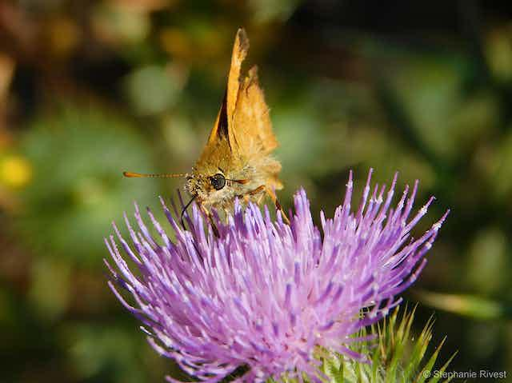
EXOTIC SPECIES AND BIODIVERSITY LOSS
zzzz
GROUP 2 ( TOPIC 11)

Slide 2
OUTLINE
Concept of exotic species and it impact on biodiversity
Examples of exotic species and their ecosystem
Importance and disadvantages
Biodiversity and the importance of maintaining a healthy ecosystem
How exotic species contribute to biodiversity loss
Conclusion
References

Slide 3
Concept of exotic species and it impact on biodiversity
Exotic species are organisms that have been introduced to a new geographical areas outside their natural habitats and it is done intentionally or unintentionally.
Other relating terms includes,
Biological invasion: Naturally occurring but exotic species which are introduced by humans and human's activities.
Cryptogenic species: species whose origins are not known and can be exotic or native.

Slide 4

The concept of invasive species:
extinctions of native plants and animals
reducing biodiversity
competing with native organisms for limited resources
altering habitats
This can result in huge economic impacts and fundamental disruptions of coastal and Great Lakes ecosystems.
Fig.1; Habitat fragmentation

Slide 5
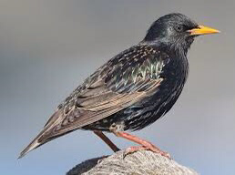
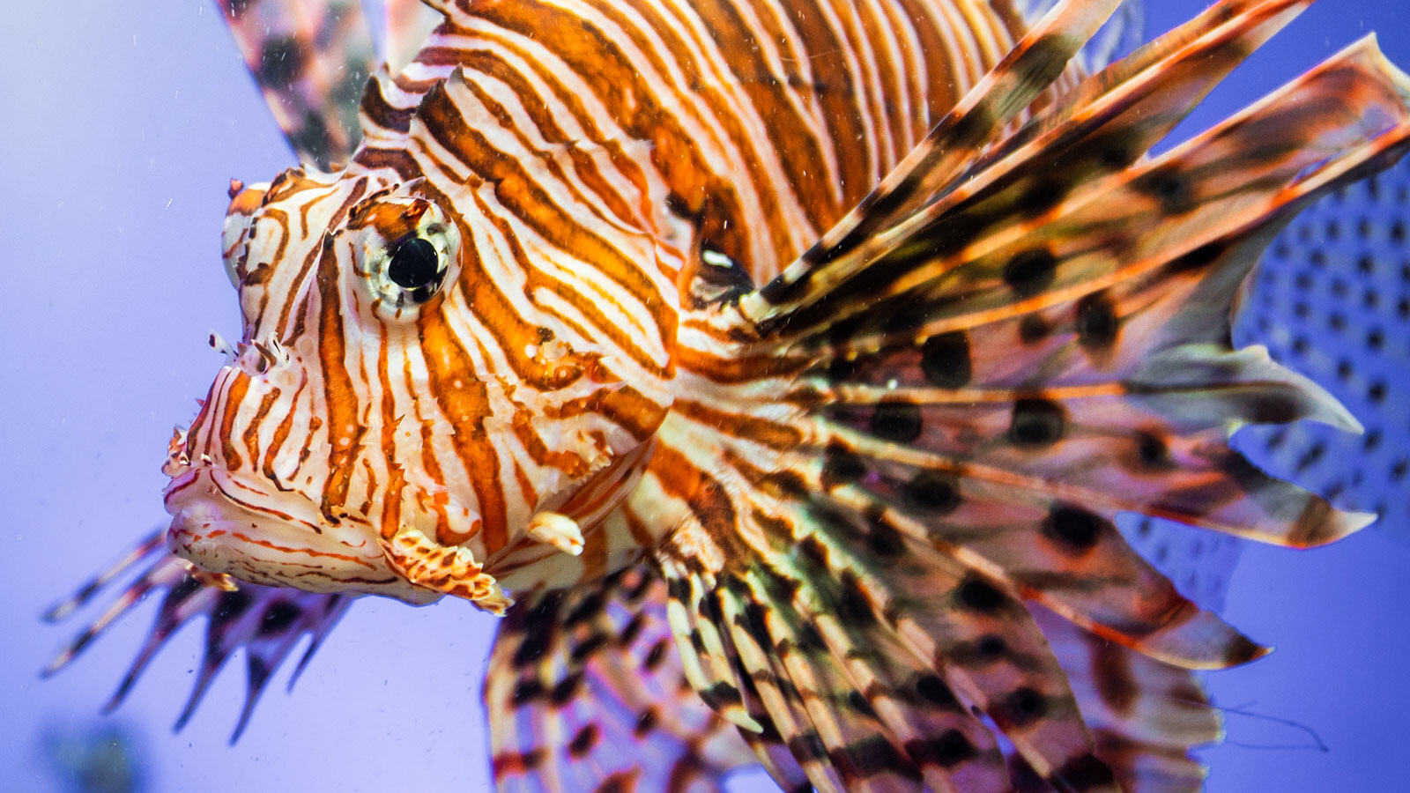
Examples of exotic species and their ecosystem
Exotic species can exist in several ecosystems such as the marine, forest, grassland and desert ecosystems.
Fig 2; European starling. Fig.3; Lionfish.

Slide 6
Types of exotic species
Neophyte ( introduced plant species)
Neozoa (introduced animal species)
Fungi

Slide 7
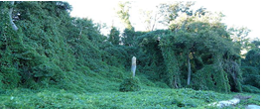
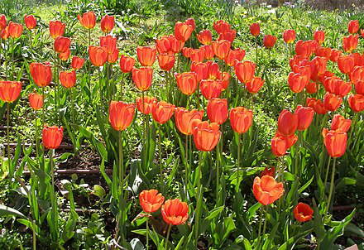
Neophyta
Invasive
Noninvasive
Fig.4; Kudzu(Pueraria Montana var lobata)- native to Japan
Fig.5; Tulipa spp.-Native to central Asia

Slide 8
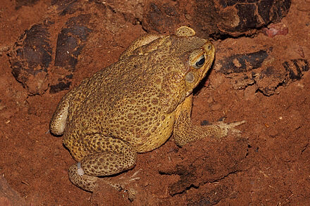
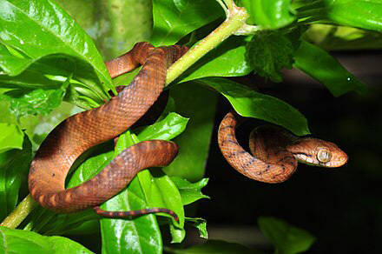
Neozoa
Invasive
Fig.6; Cane toad(Rhinella marina)- Native to south and Central America.
Fig.7; Brown tree snake- Native to Australia

Slide 9
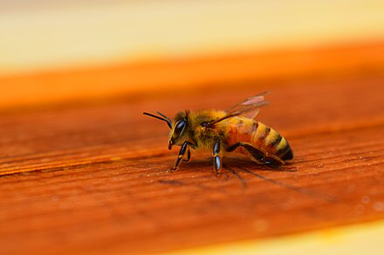
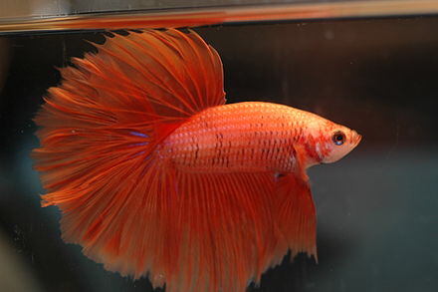
Noninvasive
Fig.8; Honeybees(Apis mellifera)-Native to Europe Africa and Asia
Fig.9; Siamese fighting fish- Native to Southeast Asia

Slide 10
How exotic species differ from native species
Exotic species vary in many ways from native species which include;
Origin and range
Evolutionary adaptations

Slide 11
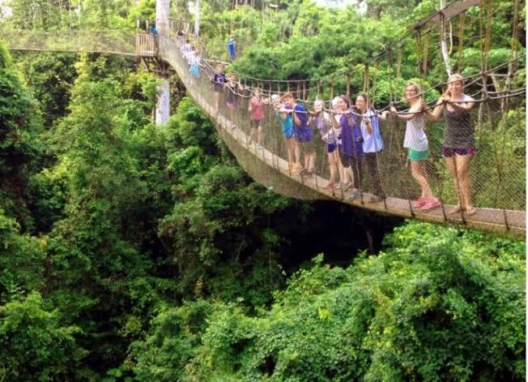
Advantages of Exotic species
Medicinal purposes
Food
Research and educational purposes
Tourism
Fig.10; Kakum National Park

Slide 12
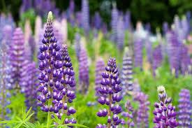
Disadvantages of exotic species
• Invasiveness
• Lack of adaptations
•Economic costs
Fig.11; Invasive species in Scandinavia, Northern Europe

Slide 13
Biodiversity and its importance
Biodiversity includes the plants, animals, insects and microorganisms that live on our planet.
Every one of these live and work together in ecosystems to maintain and support life on earth and exist in a delicate balance

Slide 14
Importance of maintaining a healthy ecosystem
Climate Regulation
Economic Value
Cultural and Recreational Value
Health and Well-being

Slide 15
How exotic species contribute to biodiversity loss
• Predation
•Habitat alteration
• Disease transmission
• Hybridization and genetic pollution

Slide 16
Conclusion
In conclusion, the introduction of exotic species poses a significant threat to biodiversity, as it can lead to the loss of native species and disrupt delicate ecosystems, underscoring the urgent need for proactive measures to prevent further harm and safeguard the diversity of our natural world.

Slide 17


Slide 18
References
https://www.cwss.org
.Levine, J. M., & D'Antonio, C. M. (1999). Elton revisited: a review of evidence linking diversity and invasibility. Oikos, 87(1), 15-26.
2. Simberloff, D., & Von Holle, B. (1999). Positive interactions of nonindigenous species: invasional meltdown?. Biological Invasions, 1(1), 21-32.
3. Vitousek, P. M., D'Antonio, C. M., Loope, L. L., & Rejmanek, M. (1997). Introduced species: a significant component of human-caused global change. New Zealand Journal of Ecology, 21(1), 1-16.
4. Daszak, P., Cunningham, A. A., & Hyatt, A. D. (2000). Emerging infectious diseases of wildlife--threats to biodiversity and human health. Science, 287(5452), 443-449.

Slide 19
NAME INDEX NO.
Appiah-Kubi Antoinette 9201419
Amoah Daniel 9198619
Agyapong Jonathan Kwame 9197217
Avukor Alberta Sherry 9203319
Unicorn Nancy 9220219
Obour Tannor Josephine 9219519
Kenny Collins 9210519
Kingsley Konneh Tanoh 9219619
Inusah Abdul-Basit 9210119
Ofosu Esther Abankwah 9214919

